Slide 1
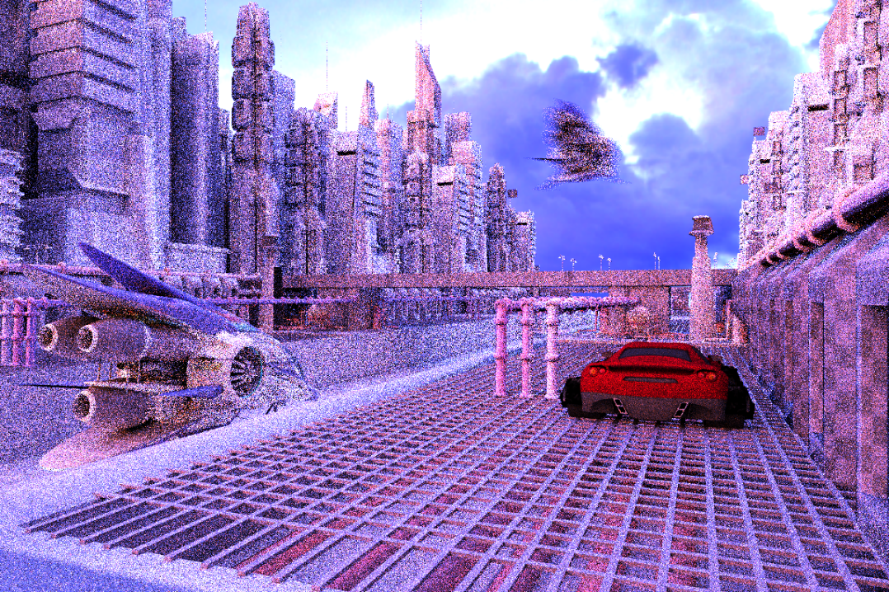
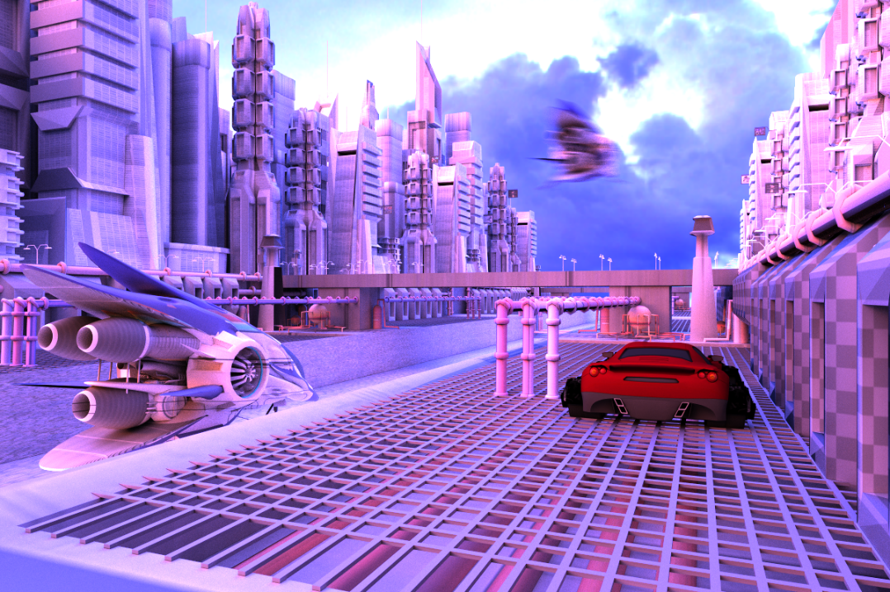

General Framework for
Monte Carlo Filtering
scene by Herminio Nieves and tf3dm.com user ysup12
Notes:
Here I am going to present a general framework for all the filtering approaches. Note that here we only talk about the reconstruction and not sampling.

Slide 2
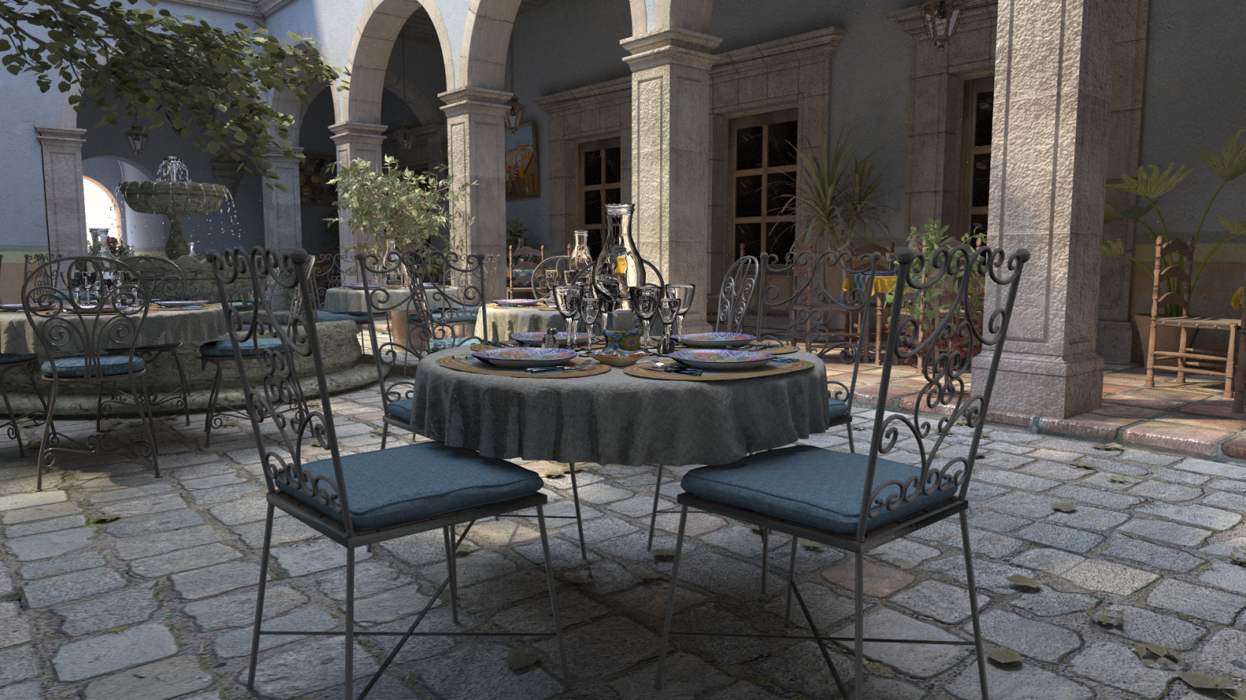
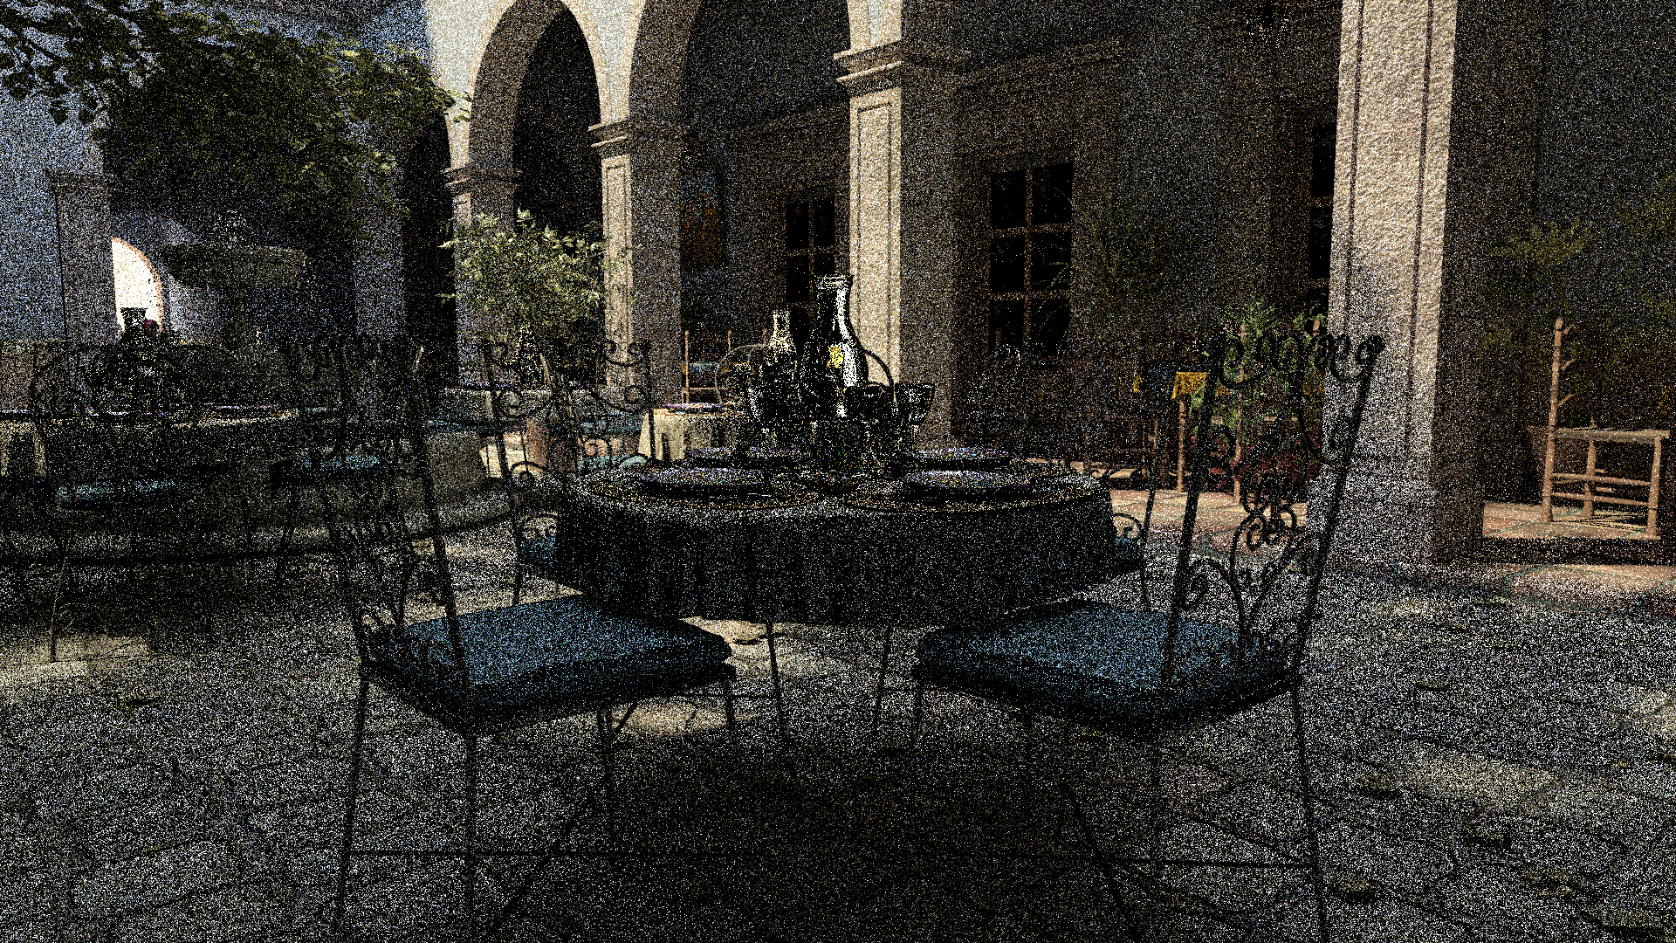
Observations
After only a few minutes, we have a lot of information about the scene…
Can we filter this to get a result as good as a reference image?
scene rendered in a few minutes (8 samples/pixel)
scene rendered in over 24 hrs (8,192 samples/pixel)
scene by M. Leal Llaguno

Slide 3
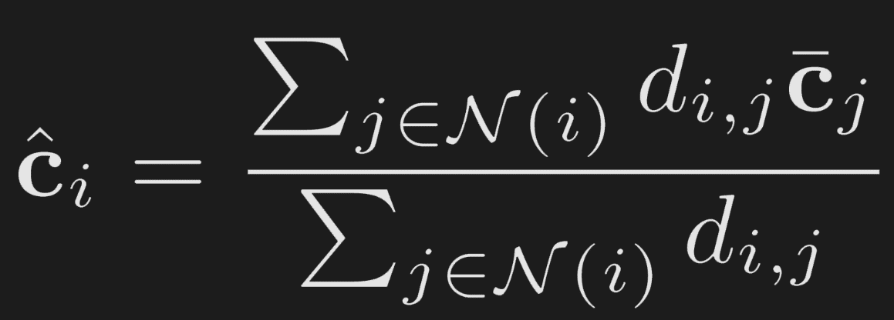

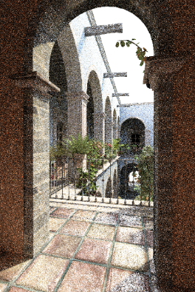

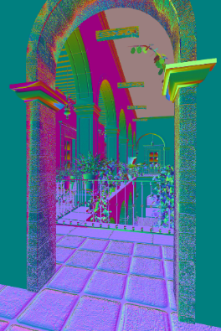
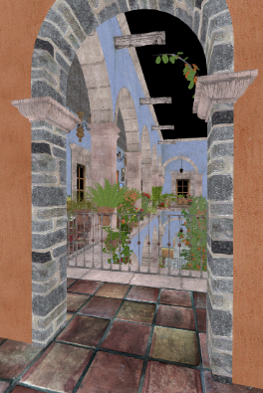
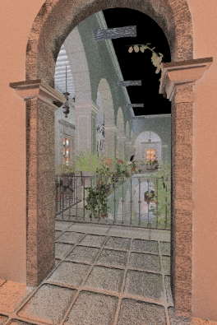
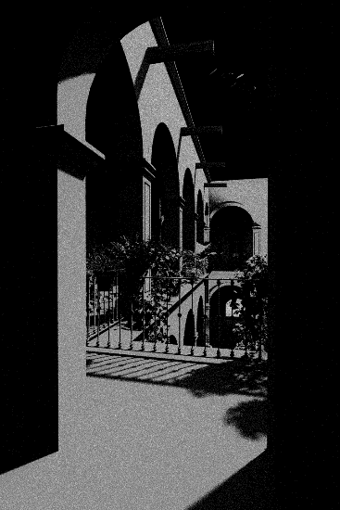
Filter
noisy pixel
neighborhood
of pixel i
contribution of
of pixel j to i
screen
position
pixel
color
world
positions
shading
normals
texture
1st bounce
texture
2nd bounce
visibility
Notes:
Simple filters only use screen position and pixel color, but in MC rendering we have access to several additional features including world positions, shading normals, texture values and so on. Since these features are highly correlated with the scene, utilizing them in the filter significantly improves the quality of filtered results.

Slide 4
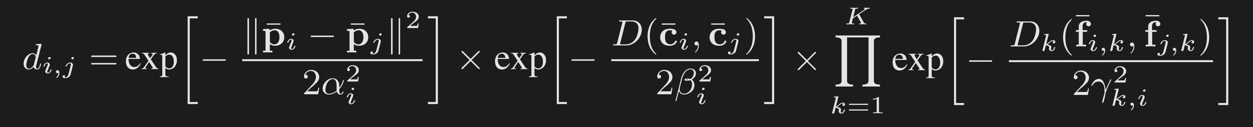




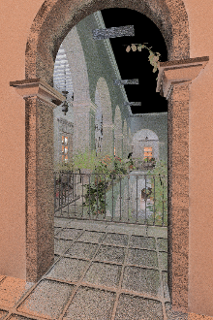


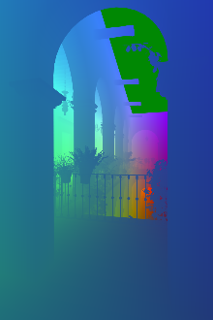


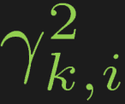
Cross-bilateral filter
, , and are the variance of each term (filter parameters)
screen
position
pixel
color
additional
features
Notes:
For example in a cross-bilateral filter the weight is given by this equation which has multiple terms. It basically computes the Gaussian distance of the pixels based on their screen position, pixel color and several additional features that I talked about.
And these must be set correctly at every pixel independently.

Slide 5
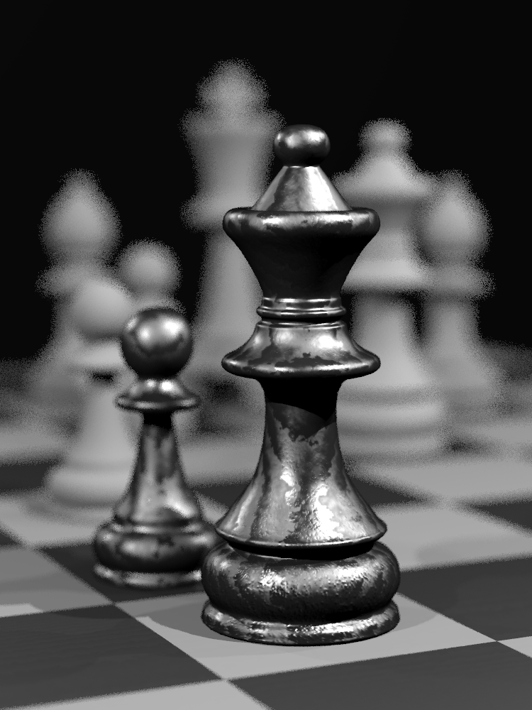
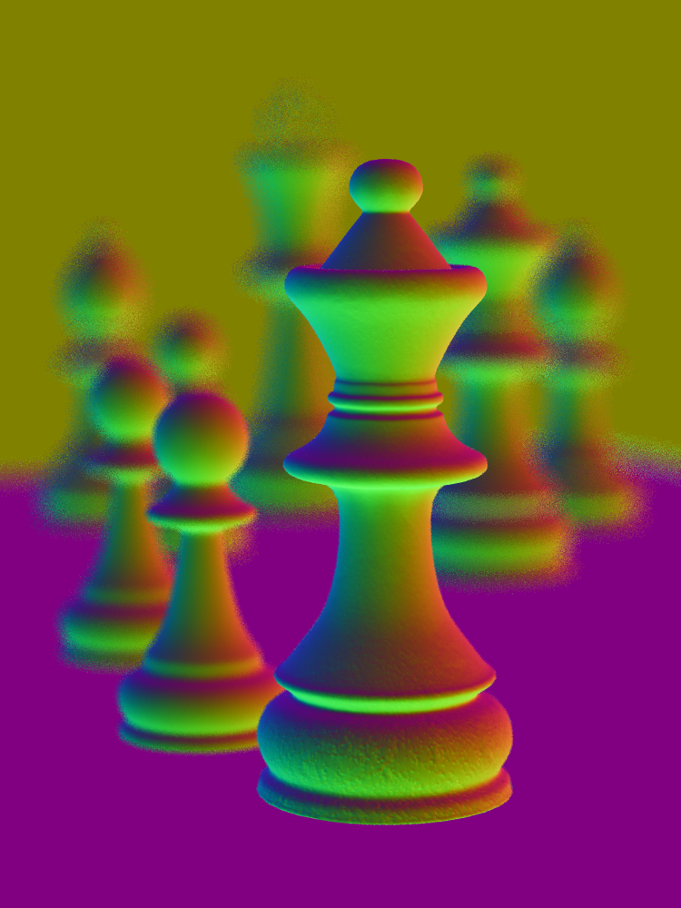
Why per pixel parameters?
input MC 8 samples/pixel
shading normals
Notes:
Now let’s see why we need to vary these parameters per pixel. Here is a chess scene containing depth of field and a visualization of the shading normal is shown on the right.
This is a chess scene containing depth of field and I have visualized the shading normal. In the out of focus region which contains noise, it is important to ignore the normal to be able to filter it and produce smooth result

Slide 6
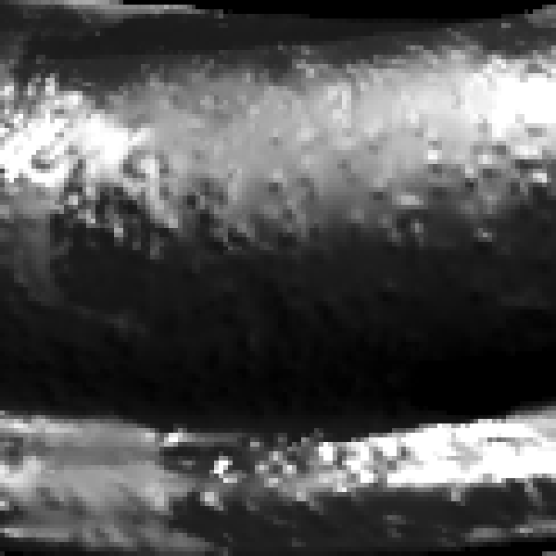
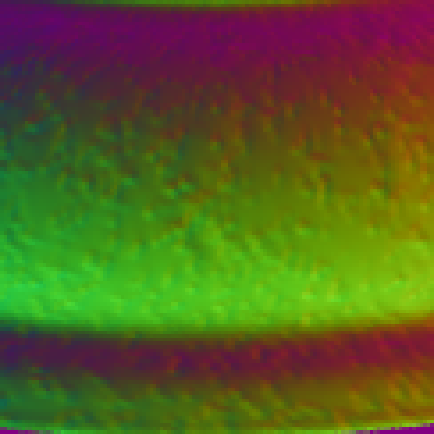

Why per pixel parameters?
input MC
8 samples/pixel
shading normals
ground truth

Slide 7
Why per pixel parameters?
input MC 8 samples/pixel
shading normals

Slide 8
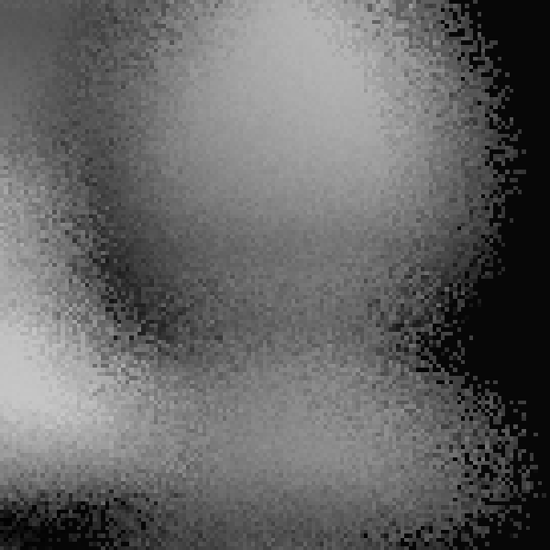
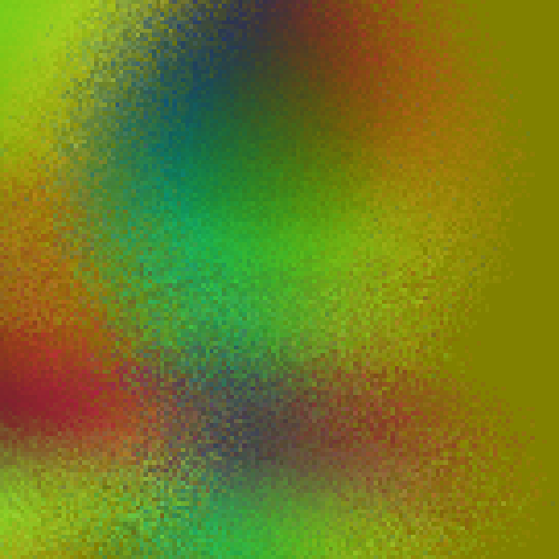
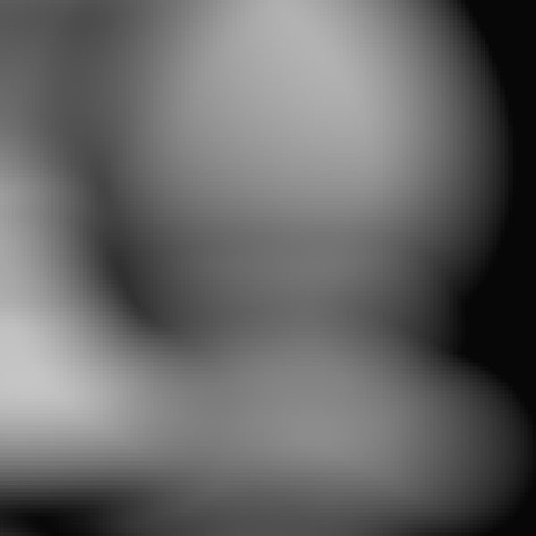
Why per pixel parameters?
input MC
8 samples/pixel
shading normals
ground truth

Slide 9
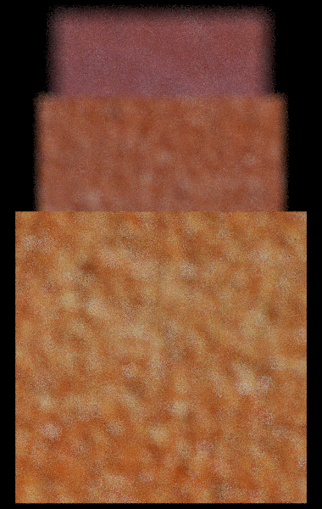
Another example
out-of-focus quad
MC noise
Depth-of-field scene
scene detail
in-focus quad
8 samples/pixel
Notes:
Here we have three textured quads each with a noisy looking pattern. The front quad is in focus and the furthermost quad is out of focus. The challenge is to develop a filter that can preserve the scene detail on the front quad while removing the noise from the furthermost quad.

Slide 10

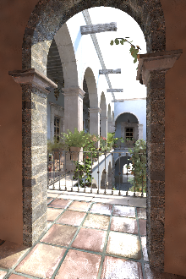




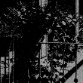
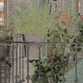
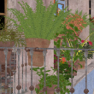
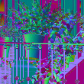



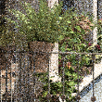
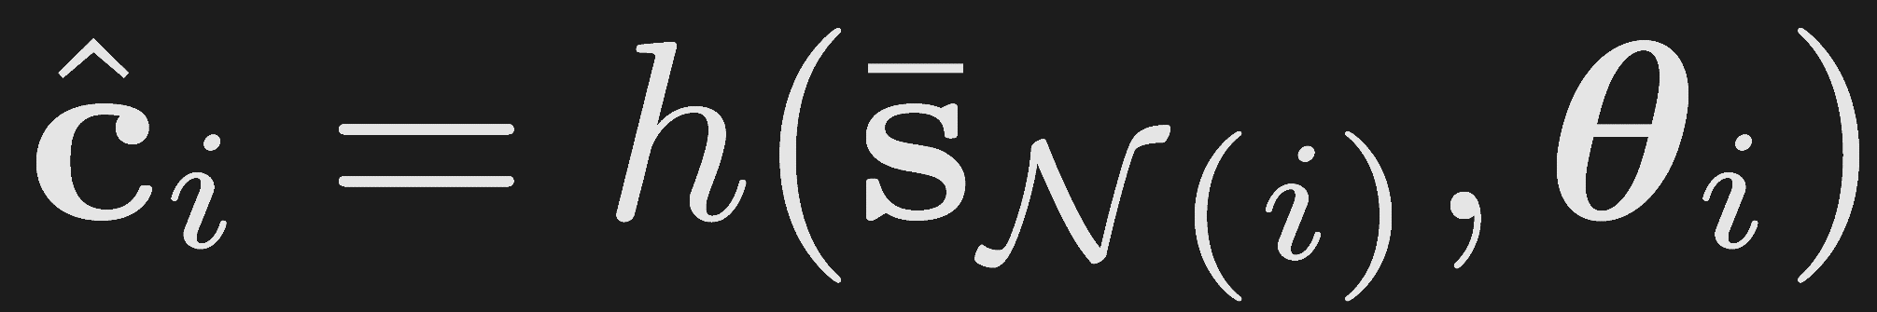
Problem formulation
Direct estimation
Error-minimization
filter parameters
local
features
filter
filtered
pixel
filtered
image
cross-bilateral filter
cross non-local means filter
from MC renderer
scene
features
should be estimated
features
parameters
Notes:
The approaches that we present in this course either directly estimate the filter parameters from the input data or try to minimize the error between the filtered and ground truth image.

Slide 12
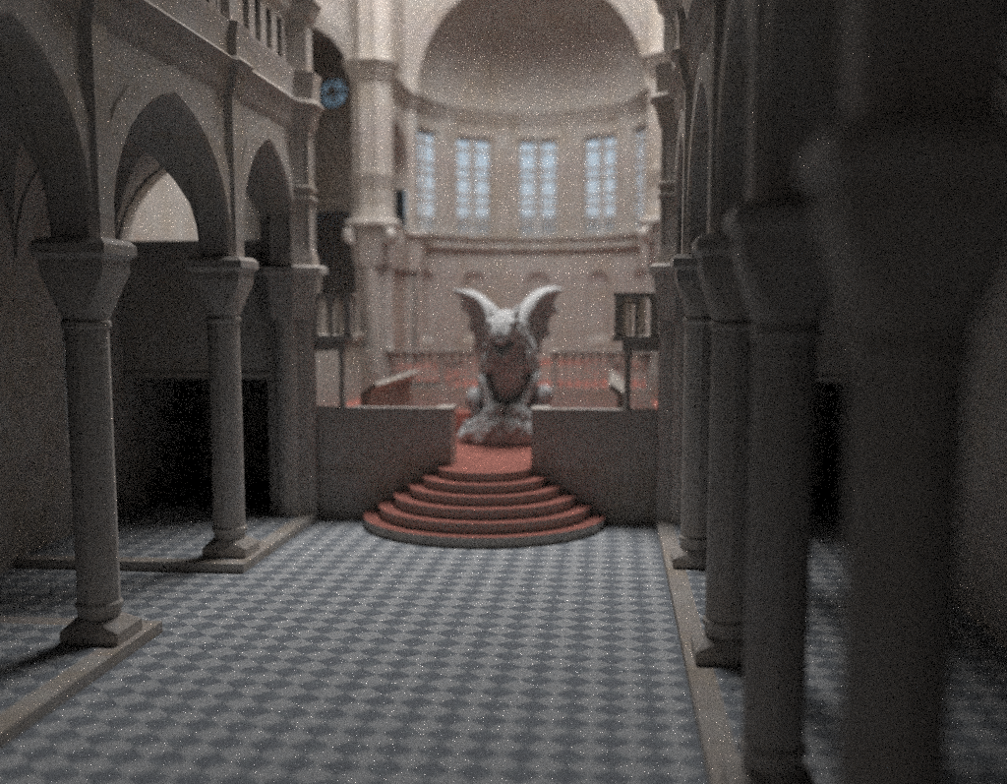
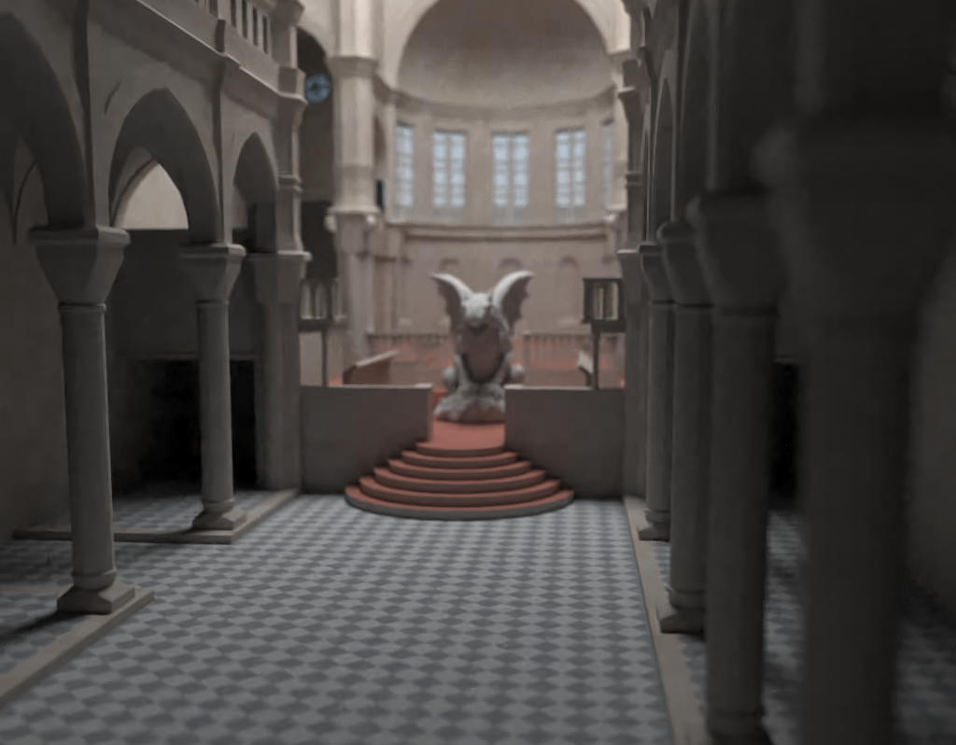
Leveraging General Image Denoising
Algorithms for MC Denoising
scene by Marko Dabrovic and Mihovil Odak
Notes:
Now I am going to talk about one of our earlier work which directly estimates the filter parameters and uses only pixel color information.

Slide 13
Motivation
Image denoising techniques
Donoho and Johnstone [1994]; Chang et al. [2000]; Portilla et al. [2003]; Muresan and Parks [2003]; Buades et al. [2005]; Awate et al. [2006]; Aharon et al. [2006]; Elad and Aharon [2006]; Kervrann and Boulanger [2006]; Luisier et al. [2007]; Dabov et al. [2007]; Liu et al. [2008]; Kervrann and Boulanger [2008]; Mairal et al. [2008]; Brunet et al. [2009]; Chatterjee and Milanfar [2009]; Mairal et al. [2009]; Joshi et al. [2009]; Zhang et al. [2010]; Angelino et al. [2010]; Chatterjee and Milanfar [2012]

Slide 14
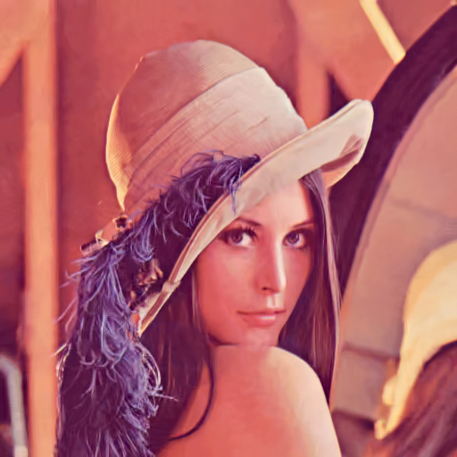
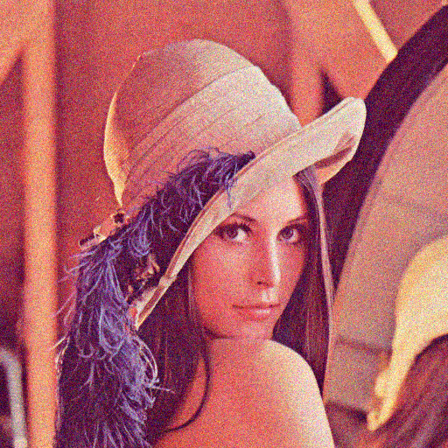
Motivation
Image denoising techniques
ü
  High Quality
  Fast
  Assume spatially invariant noise
ü
û
  Denoised
  Noisy

Slide 15
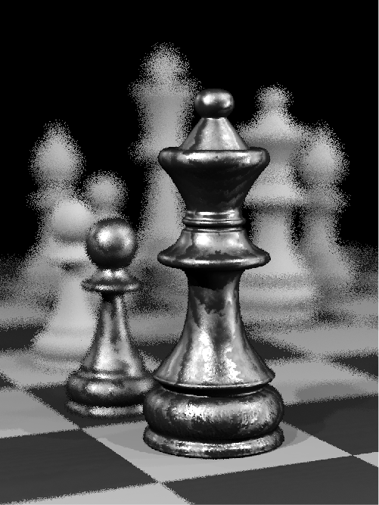
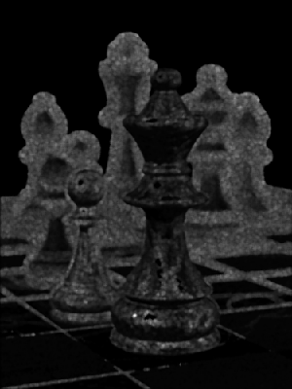
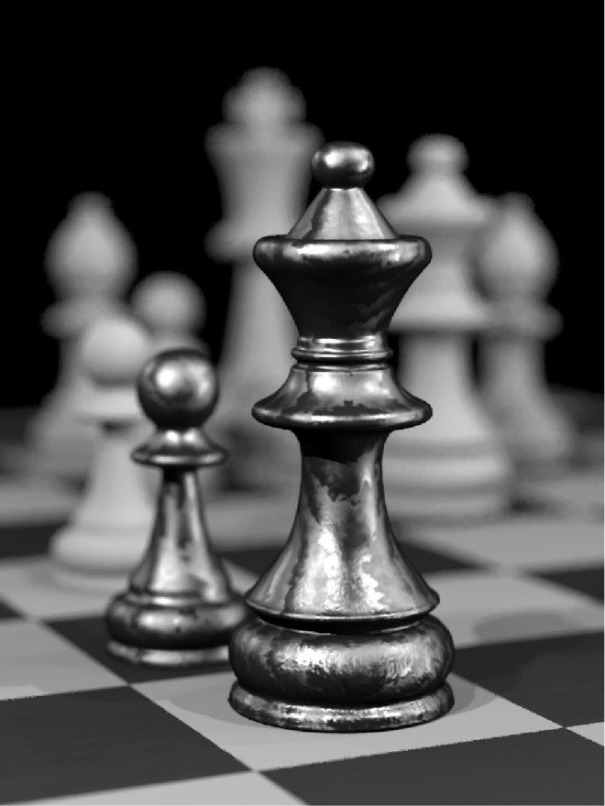
Our approach
Estimate noise level at each pixel
Denoise each part of image using its noise level with standard denoising techniques
Scene by Wojciech Jarosz
  Noisy rendered image
  Noise map
  Denoised image

Slide 16
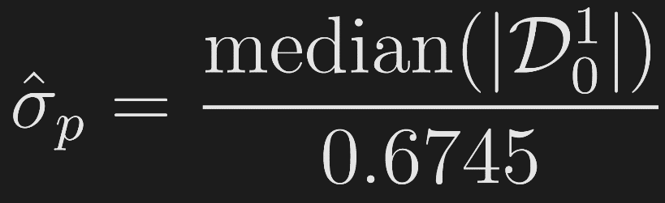
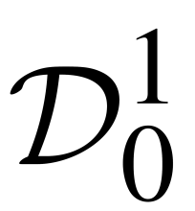
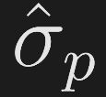

Proposed noise estimation
Median absolute deviation (MAD)
[Donoho and Johnstone 94]
  Diagonal detail coefficients of the finest level of wavelet transform
  Estimated standard deviation of noise for a window around pixel
  Assumption: noise is stationary inside a small window

Slide 17


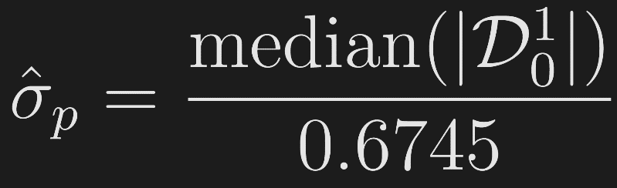
Proposed noise estimation
  Noisy rendered image
  Spatial domain
  Wavelet domain
Scene by Wojciech Jarosz
  DWT

Slide 18
Our approach
Estimate noise level at each pixel
Denoise each part of image using its noise level with standard denoising techniques
Scene by Wojciech Jarosz
  Noisy rendered image
  Noise map
  Denoised image

Slide 19
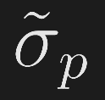
Multilevel denoising
Problem:
Denoising each pixel using its is not efficient
Our solution:
Select a small subset of noise levels
Denoise the rendered image a few times
Pick the best pixel from denoised images
How to select the best set of noise levels to filter?

Slide 20
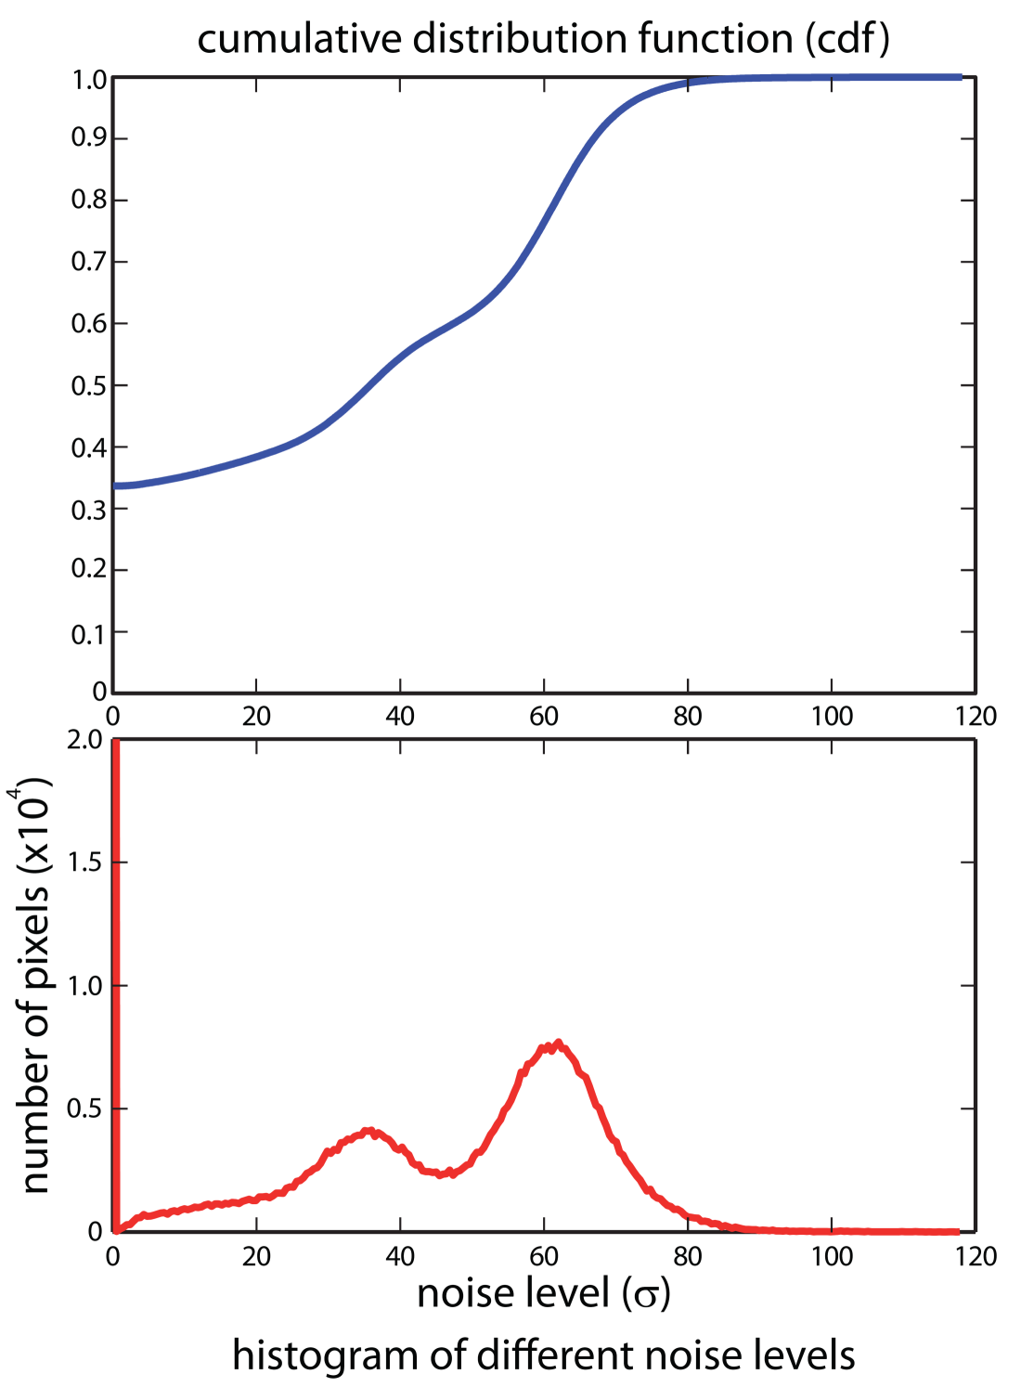
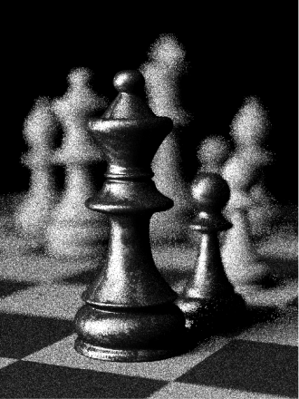
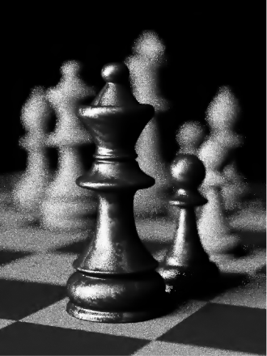





Multilevel denoising
= 0
= 28.73
= 43.16
= 57.46
= 66.44
= 118.24
Scene by Wojciech Jarosz
Notes:
Our idea is inspired by importance sampling. This is the histogram of the noise levels and we would like to sample more in the regions with higher probability. To do that we first compute the cdf, and then uniformly sample the vertical access to get the representative levels. As you see we have more levels on the peaks of the histogram. Once we have these we can denoise the image with these few noise levels.

Slide 21
Multilevel denoising
For each pixel pick the two closest layers
Interpolate the pixel value

Slide 22
Adaptive sampling
We can use the noise estimation to sample more in the noisier regions

Slide 23
Results
Evaluated our framework using two image denoising algorithms
  BLS-GSM [Portilla et al. 2003]
  BM3D [Dabov et al. 2007]

Slide 24
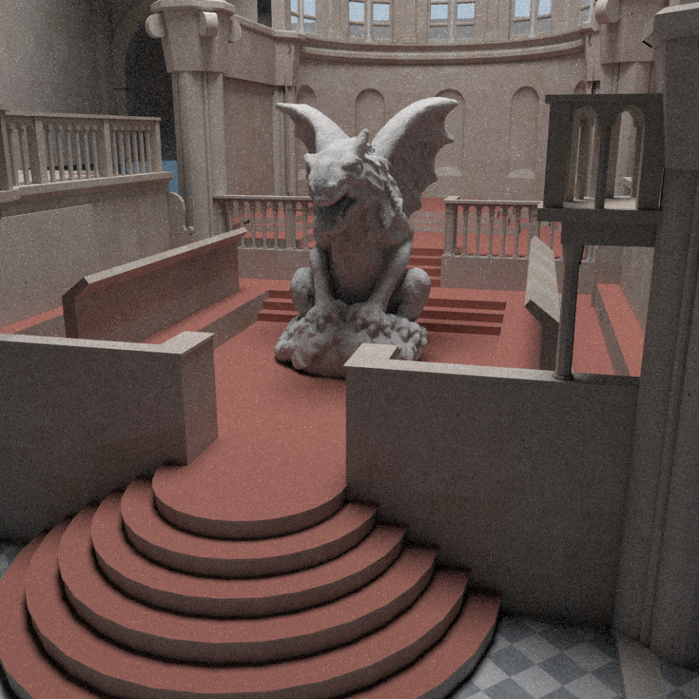


Gargoyle (GI)
32 samples/pixel
16K samples/pixel
Input MC
87.1 s
Ground truth
~ 12 hours
Ours (BM3D)
98.6 s
Scene by INRIA via the AIM@SHAPE repository

Slide 25

Gargoyle (GI)
32 samples/pixel
16K samples/pixel
Ours (BLS-GSM)
168.2 s
Ground truth
~ 12 hours
Ours (BM3D)
98.6 s
Scene by INRIA via the AIM@SHAPE repository

Slide 26



Gargoyle (GI)
Ours (BLS-GSM)
Ours (BM3D)
GT
168.2 s
2.47x10⁻³
0.988
98.6 s
2.00x10⁻³
0.989
Relative MSE
SSIM

Slide 27
Results
Comparison
  Our method with BM3D
  ASR [Rousselle et al. 2011]

Slide 28



Sibenik (GI + DOF)
32 samples/pixel
4K samples/pixel
Input MC
81.4 s
Ground truth
~ 3 hours
Ours (BM3D)
93.0 s
Scene by Marko Dabrovicand MihovilOdak

Slide 29
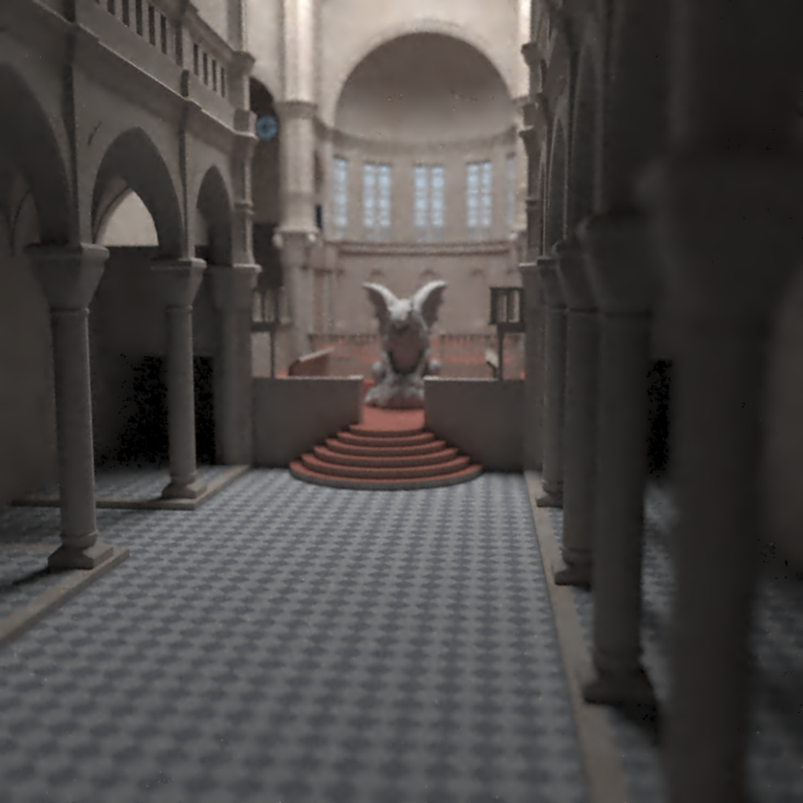
Sibenik (GI + DOF)
32 samples/pixel
4K samples/pixel
Rousselle et al. 2011 (ASR)
92.6 s
Ground truth
~ 3 hours
Ours (BM3D)
93.0 s
Scene by Marko Dabrovicand MihovilOdak

Slide 30
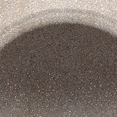
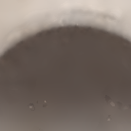
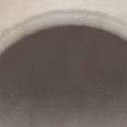

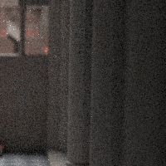



Sibenik (GI + DOF)
Input MC
ASR
Ours (BM3D)
GT
81.4 s
28.90x10⁻³
0.952
92.6 s
3.10x10⁻³
0.975
93.0 s
2.68x10⁻³
0.985
Relative MSE
SSIM

Slide 31
Limitation
It relies only on pixel color information
Thus it is not able to handle cases with severe noise
Additional features in MC rendering should be utilized

Slide 32
The paper
N. K. Kalantari and P. Sen, “Removing the Noise in Monte Carlo Rendering with General Image Denoising Algorithms,” Computer Graphics Forum, Vol. 32, No. 2, May 2013 (Proceedings of Eurographics 2013)

Slide 33

Source code available!
Code available here:
http://www.ece.ucsb.edu/~psen/PaperPages/removing_MC_noise.html

Slide 34

Acknowledgments
Various artists for the test scenes
Support from National Science Foundation CAREER award (#0845396)

